Slide 1
Interactively Mapping the Global Nuclear Fuel Cycle
Omoremi Adeleke
M.S. in Computer Science 2025
Data Science R & D Intern
SNL Department 6754
SAND2024-08762PE

Slide 2


agenda
BACKGROUND
PROCESS
ROSES & THORNS
RELEVANCE
SIGNGFICANCE
Nuclear Power
Advancements
Caution
EDA
Visualization
Feature Creation
Resources
Step 1
Paths
Premise
Emergence
Awareness
Refine
Incentive
Leverage
2

Slide 3
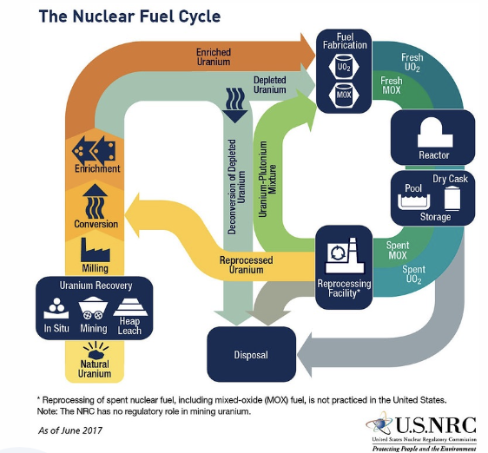
Background
Nuclear power stands as a low-carbon energy source, a pivotal role in mitigating greenhouse gas and addressing the challenges of climate change
Nuclear power's high energy density enables efficient electricity generation from a small amount of fuel, meeting large-scale energy demands – approximately 20,000x - 30,000x more electricity per metric ton compared to coal or natural gas
Technological advancements driven by the Nuclear Fuel Cycle (NFC), including reactor design, fuel reprocessing, and waste management, foster progress within the realm of nuclear power but contemporaneously in diverse fields such as medicine, industry, and space exploration
Crucially the NFC involves the production and handling of fissile materials, enriched uranium or plutonium, with potential for diversion towards the development of nuclear weapons
Illicit acquisition of these materials poses a significant risk, leading to nuclear proliferation and security threats

Slide 4
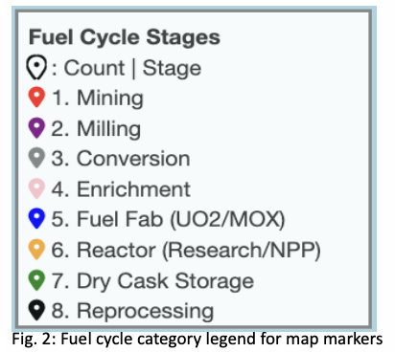
PROCESS
Nuclear power stands as a low-carbon energy source, a pivotal role in mitigating greenhouse gas and addressing the challenges of climate change
Nuclear power's high energy density enables efficient electricity generation from a small amount of fuel, meeting large-scale energy demands – approximately 20,000x - 30,000x more electricity per metric ton compared to coal or natural gas
Technological advancements driven by the Nuclear Fuel Cycle (NFC), including reactor design, fuel reprocessing, and waste management, foster progress within the realm of nuclear power but contemporaneously in diverse fields such as medicine, industry, and space exploration
Crucially the NFC involves the production and handling of fissile materials, enriched uranium or plutonium, with potential for diversion towards the development of nuclear weapons
Illicit acquisition of these materials poses a significant risk, leading to nuclear proliferation and security threats

Slide 5
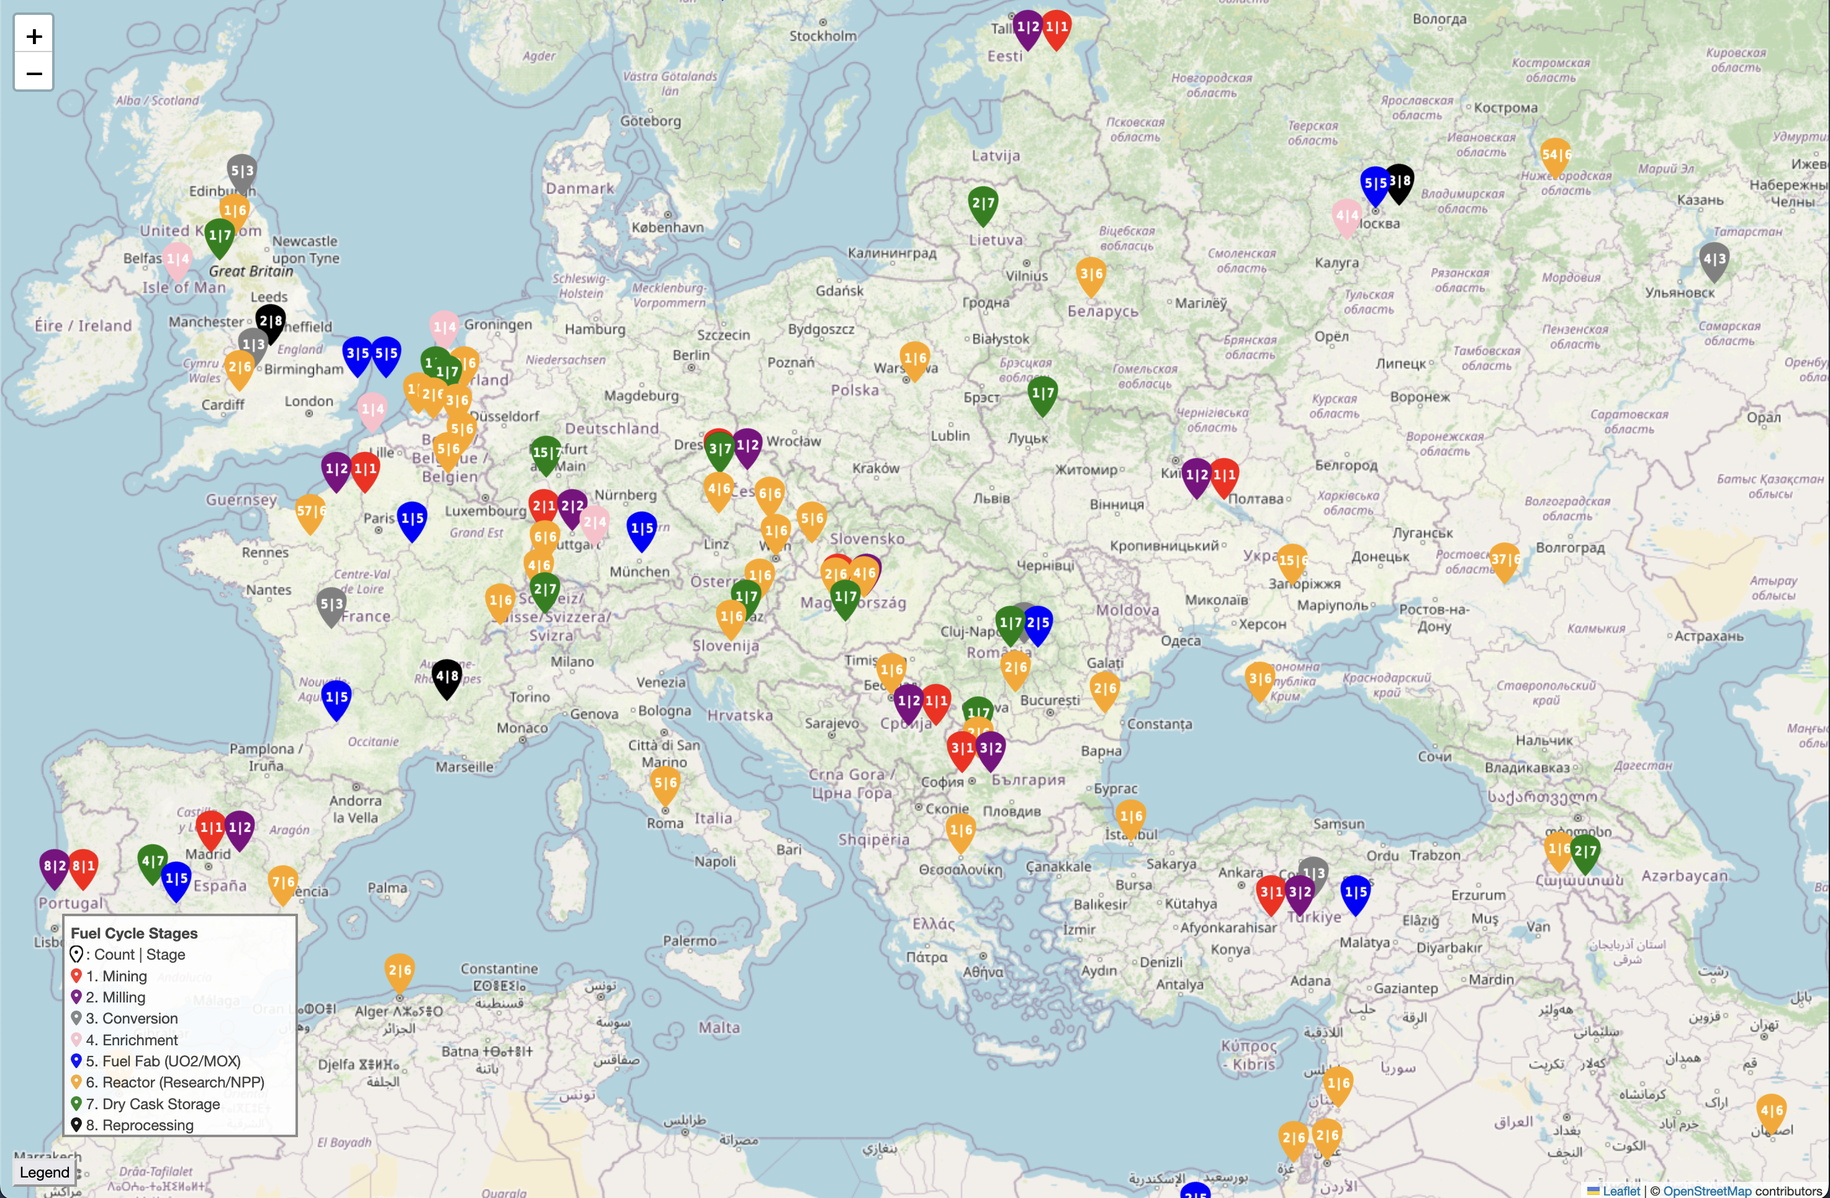
Roses & thorns

Slide 6
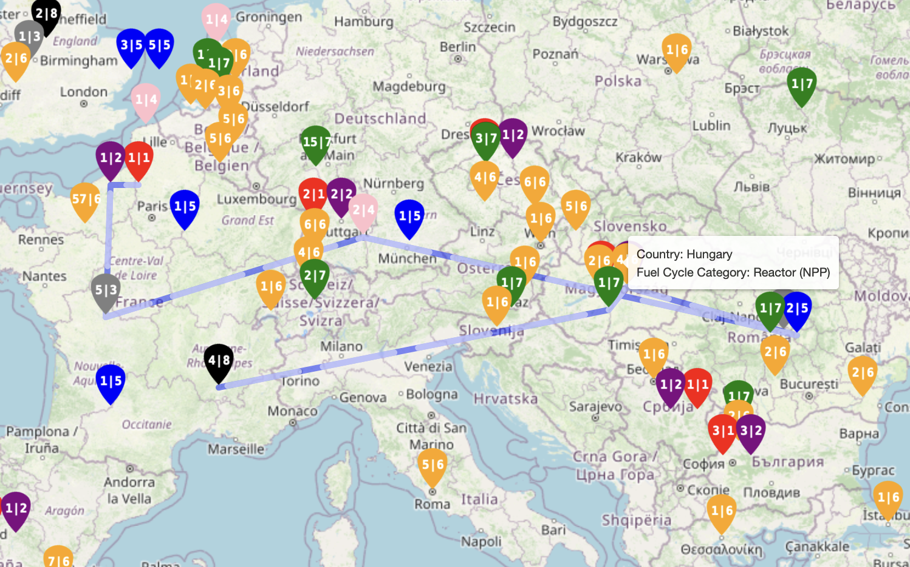
Relevance
Premise
Graphically reflect the global NFC considering the geography of the fuel cycle process on account of the NFC encompassing both inherent risks and notable benefits
Emergence
Given the emergence of new countries entering the NFC or serving as transit routes for nuclear materials, comprehending the intricate movement of NFC material assumes paramount importance
Awareness
Understanding facilitates enhanced situational awareness and enables implementation of effective risk mitigation strategies safeguarding against potential threats

Slide 7
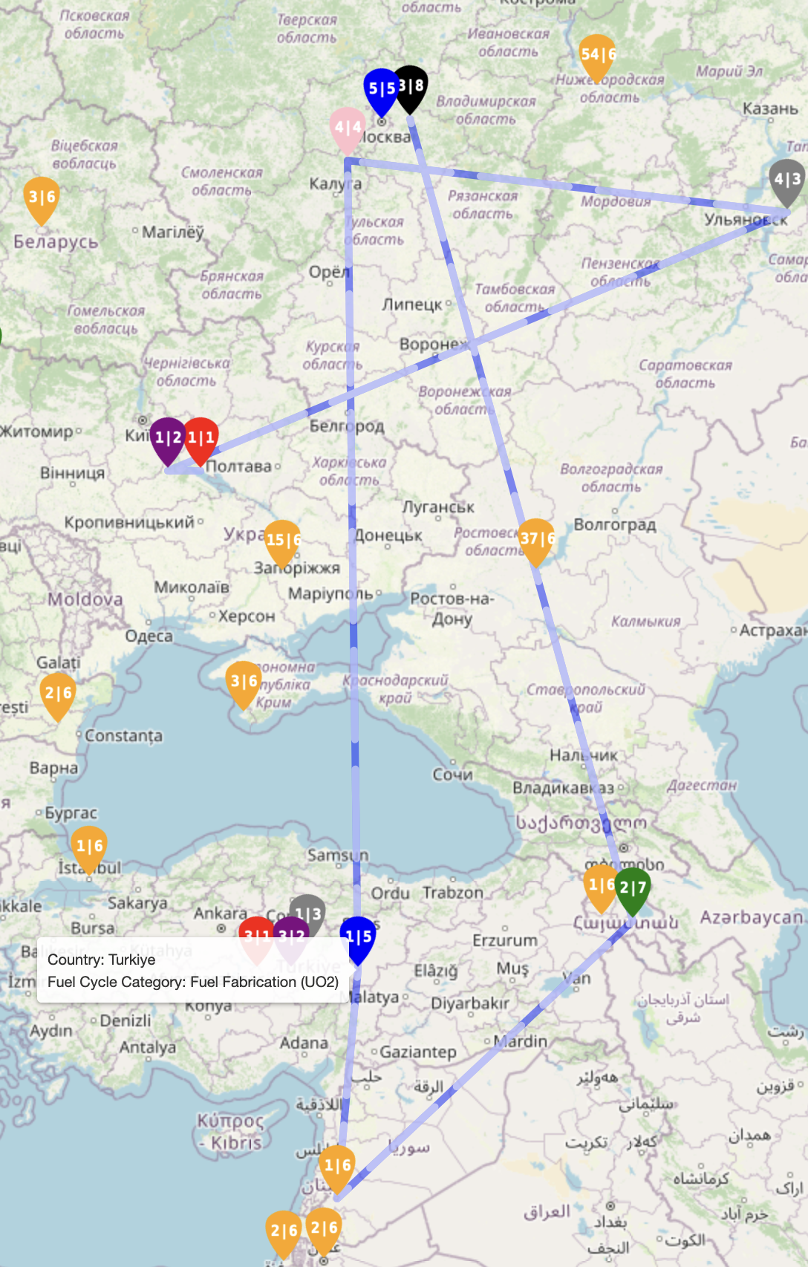
Significance
Refine
The analysis and model contribute to surveying transportation, by identifying vulnerabilities and developing strategies to enhance security measures
Incentive
The model enables what if analysis, allowing for the development of proactive policies, regulations, and risk mitigation strategies of the NFC, strengthening security measures, and informing decision-making in the global energy landscape
Dynamics
The geographic network analysis and model sheds light on the dynamics and interactions within the NFC, providing valuable insights into relationships between countries involved
Leverage
Geographic network analysis and modeling, we can ensure the responsible and sustainable utilization of nuclear resources

Slide 8
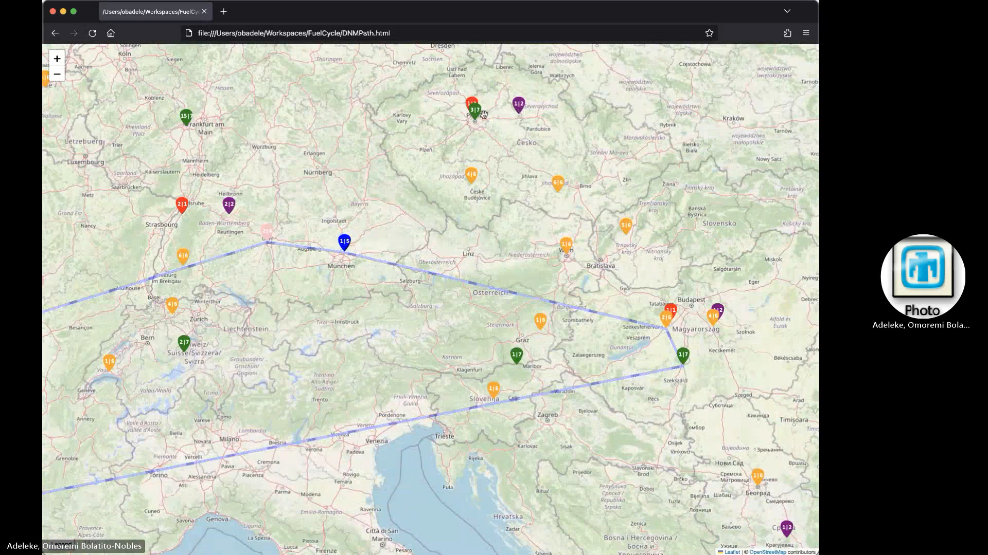

Slide 9
Questions?

